Slide 1
Croeso
Welcome
June 11th 2019

Slide 2
School Uniform supplier

Slide 3
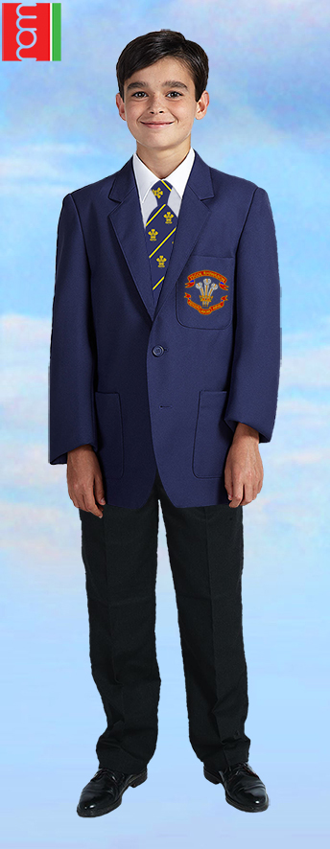

Slide 4
Uniform requirements
Blazer with school badge
School tie (clip on)
Formal white shirt with collar
Optional plain black V-neck jumper (no logos etc. to be an option during winter months at the discretion of the Headteacher)
Black tailored, business style trousers
Black knee length skirt (optional for girls)
Plain black or grey socks (or tights for girls)
Formal, business style plain black shoes
PE Kit
Students are expected to possess the necessary and appropriate kit for Physical Education and Games.
Boys
Ysgol Rhiwabon Logo T-shirt or plain black T-shirt
Black shorts / sports leggings / joggers
Red football socks
Football boots
Black tracksuit for winter
Trainers
Girls
Plain black or Ysgol Rhiwabon Logo T-shirt
Black shorts / sports leggings / joggers
White socks
Black tracksuit
Trainers

Slide 5
GENERAL APPEARANCE
Like any reasonable organisation we allow no extremes of appearance at Ysgol Rhiwabon.
Jewellery is limited to a watch, one plain ring and one pair of plain gold or silver studs in pierced ears. No other facial piercings are allowed.
Similarly, we do not permit extreme hairstyles. Whilst we are aware that fashions change, and that yesterday's extreme is tomorrow's normal hairstyle, it should be noted that unnatural colours, 'tram lines' cut into hair, and similar marks or cuts made with hair trimmers, shaved heads or long Mohicans and stripes or bands of colour are considered an extreme of hairstyle unsuitable for school.
Excessive make-up (including coloured nail varnish) is also considered unsuitable for school.
Uniform and general appearance will be monitored by staff and in the case of any potential conflict the school Leadership team will be the final arbiter.

Slide 6
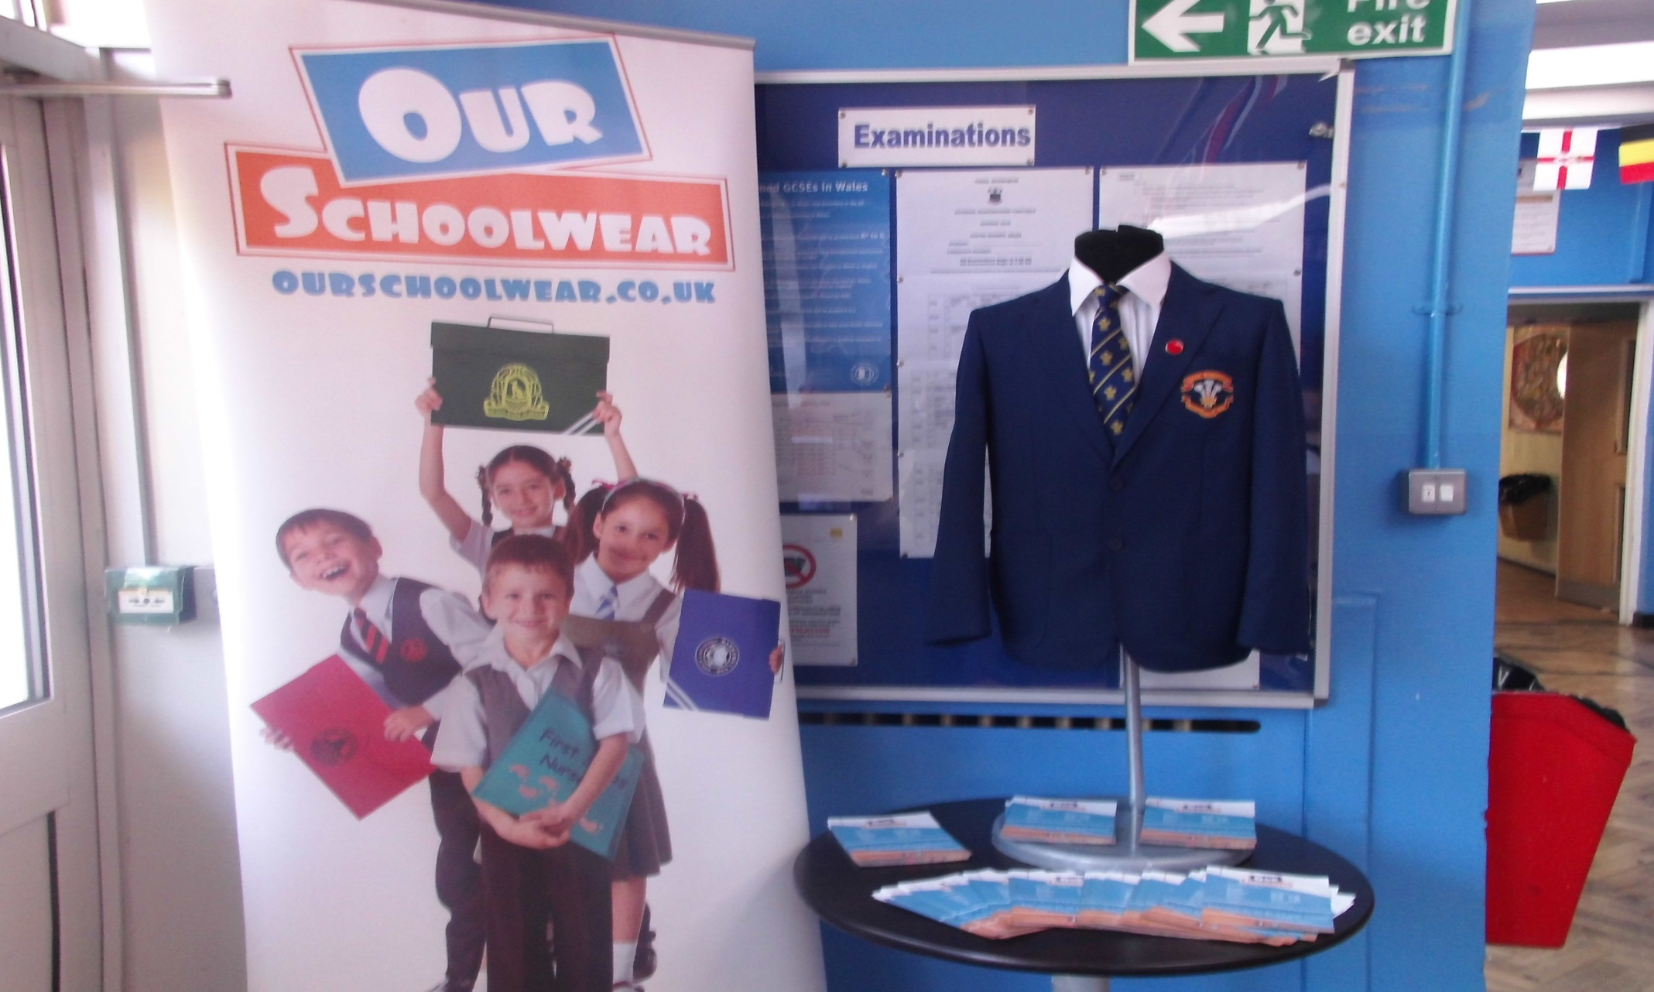

Slide 7
Ysgol Rhiwabon School Council Rules for School Blazers

Slide 8
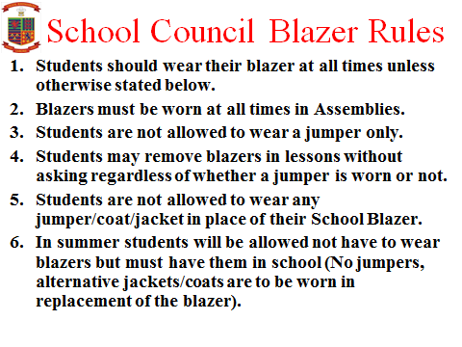

Slide 9
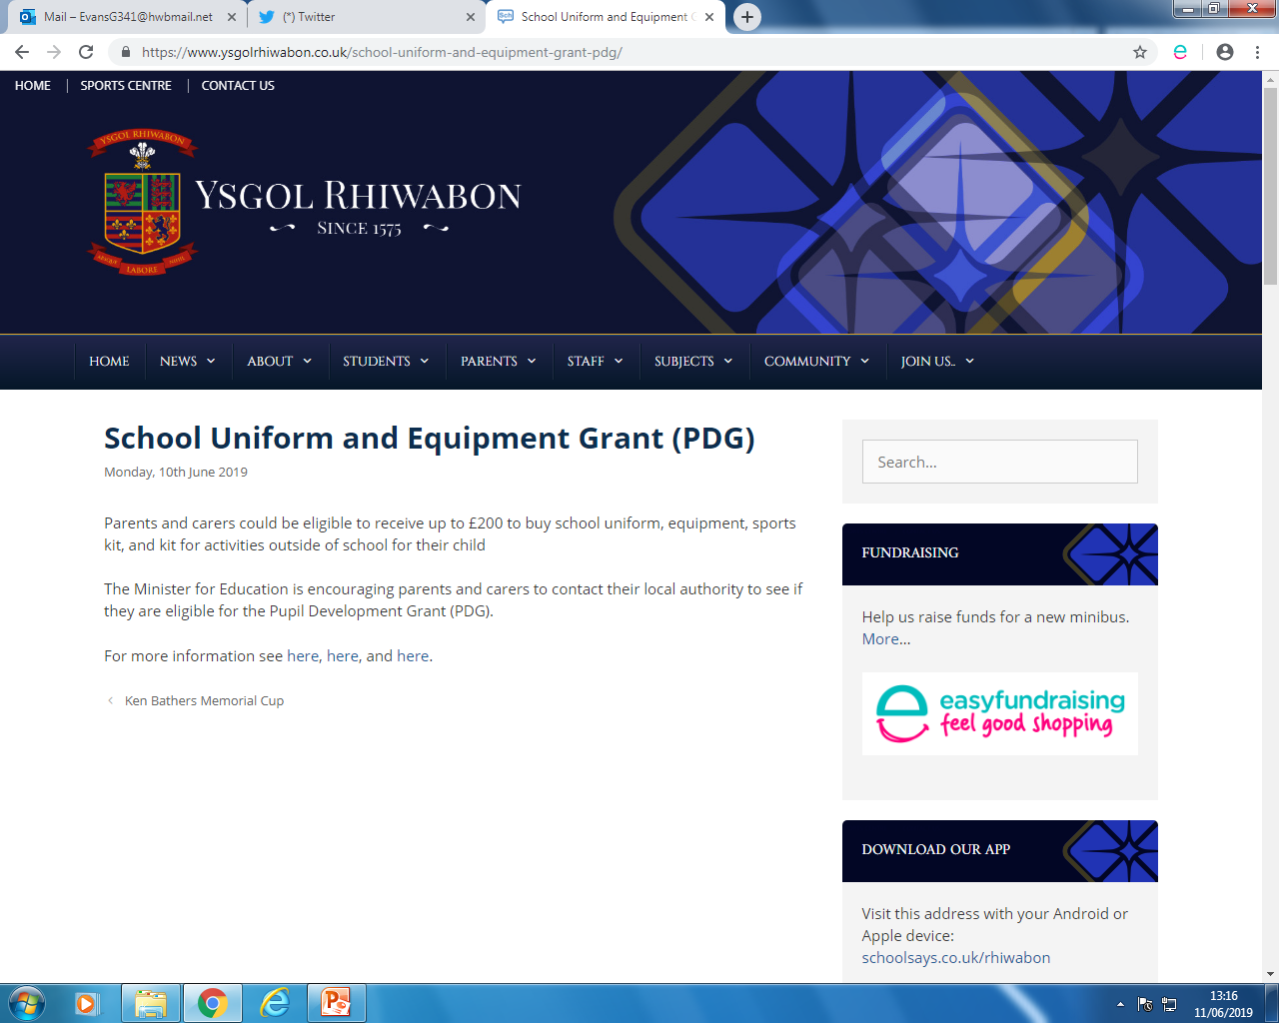

Slide 10
PRESS RELEASE from the welsh government june 10th 2019
You could be eligible to receive up to £200 to buy school uniform, equipment, sports kit and kit for activities outside of school for your child
The Minister for Education, Kirsty Williams, is encouraging parents and carers to contact their local authority to see if they are eligible for the Pupil Development Grant (PDG) – Access.
The Welsh Government fund, which has doubled to over £5 million this year, supports families with the costs of school uniform and sports kit, and equipment for activities both inside and outside of school.
The grant is central to the Minister’s commitment to remove barriers to learning and ensure equity and excellence for all children and young people.
Through targeting looked after children and learners eligible for free school meals, it aims to help those families most in need of help with these expenses.
Kirsty Williams said,
No pupil should be forced to miss out on opportunities because of their personal circumstances and background. All learners should be encouraged to aim high and be supported to achieve their goals.
This fund aims to help address the greater disadvantage learners face simply by not being in a financial position to engage in extra-curricular, enrichment and after school activities.
For more information on eligibility and how to apply for this grant, please contact your local authority.

Slide 11
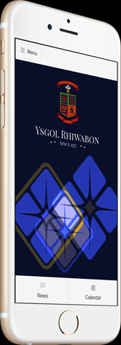
Thank you and to keep following Ysgol Rhiwabon Events go to ………..
the website and download the Free App.
Follow us on Twitter @ysgolrhiwabon

